Slide 1

SCC.361: Artificial Intelligence
2024-2025
Week 07 – Lecture 1
Introduction to Neural Networks
Hossein Rahmani
Prof in Computer Vision and Machine Learning
Email: h.rahmani@lancaster.ac.uk

Slide 2
Outline
Decision Surface
Perceptron
Binary classification
Discrete vs Continuous Perceptron
Multi-class classification
Softmax function
Error/Loss functions
Mean Square Error (MSE)
Maximum Likelihood (ML)
Cross-Entropy (CE)
Multi Layer Perceptron (MLP)

Slide 3



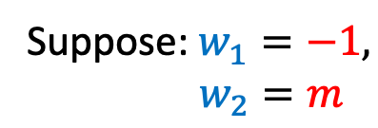





Line Equation
Line parameters ($m$ and $b$)
$$y=mx+b$$
$$y$$
$$y=mx+b$$
$$−y+mx+b=0$$
Suppose: $w_{1}=−1,$
$w_{2}=m$
$$w_{1}y+w_{2}x+b=0$$
Line parameters ($w_{1}$, $w_{2}$and$b$)
$$x$$
3

Slide 4

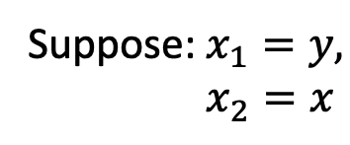


Line Equation
Line parameters ($w_{1}$, $w_{2}$and$b$)
$$y$$
$$w_{1}y+w_{2}x+b=0$$
$$w_{1}y+w_{2}x+b=0$$
Suppose:$x_{1}=y,$
$x_{2}=x$
$$x$$
4

Slide 5




Line Equation
Line parameters ($w_{1}$, $w_{2}$and$b$)
$$x_{1}$$
$$w_{1}y+w_{2}x+b=0$$
$$w_{1}x_{1}+w_{2}x_{2}+b=0$$
Suppose:$x_{1}=y,$
$x_{2}=x$
$$w_{1}x_{1}+w_{2}x_{2}+b=0$$
$$x_{2}$$
5

Slide 6

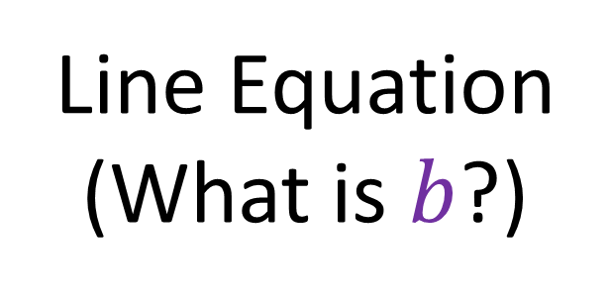


Line Equation
(What is $b$?)
$$x_{1}$$
It allows you to move the line down and up fitting the prediction with the data better.
$${w_{1}x}_{1}+{w_{2}x}_{2}+b=0$$
$$x_{2}$$
6

Slide 7

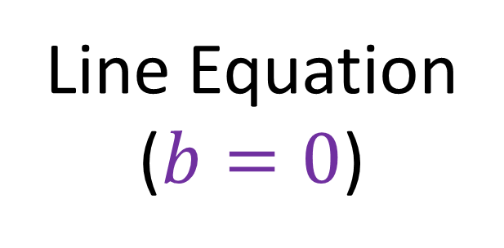
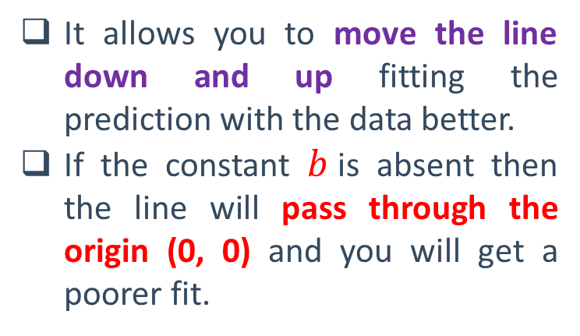
Line Equation
($b=0$)
$$x_{1}$$
$${w_{1}x}_{1}+{w_{2}x}_{2}=0$$
It allows you to move the line down and up fitting the prediction with the data better.
If the constant $b$is absent then the line will pass through the origin (0, 0) and you will get a poorer fit.
(0, 0)
$$x_{2}$$
7

Slide 8





Decision Surface (Linear Decision Boundary)
$$x_{1}$$
$${w_{1}x}_{1}+{w_{2}x}_{2}+b=0$$
A
A
A
Decision
Boundary
$${w_{1}x}_{1}+{w_{2}x}_{2}+b≥0$$
B
A
A
B
$${w_{1}x}_{1}+{w_{2}x}_{2}+b<0$$
A
B
A
B
$$x_{2}$$
8

Slide 9
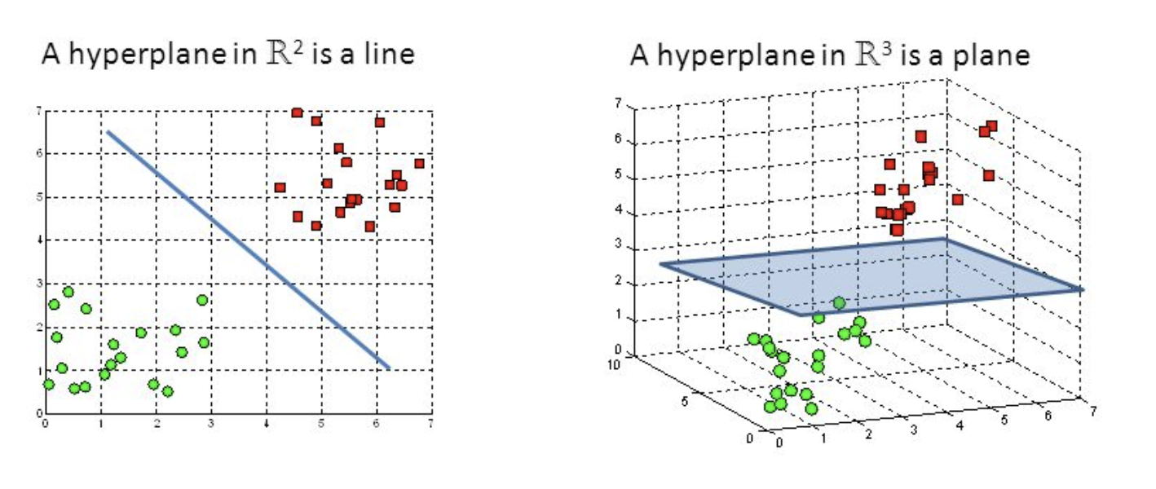







Decision Surface
(Higher Dimension, e.g. 3D)
$${w_{1}x}_{1}+{w_{2}x}_{2}+b=0$$
$${w_{1}x}_{1}+{w_{2}x}_{2}+{w_{3}x}_{3}+b=0$$
$$x_{3}$$
$$x_{1}$$
$$x_{2}$$
$$x_{2}$$
$$x_{1}$$
General: ${w_{1}x}_{1}+{w_{2}x}_{2}+{w_{3}x}_{3}+…+{w_{n}x}_{n}+b=0$
9

Slide 10


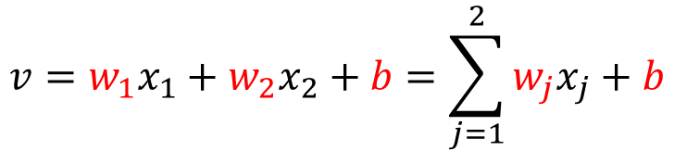

Perceptron (2 Inputs)
$$y$$
threshold function
+1
Input
signal
Synaptic
weights
1
Bias
b
$$v$$
x₁
w₁
Activation
function
Σ
Output
v
ϕ(.)
$$y=φ(v)$$
x₂
w₂
Summing
junction
$${v=w_{1}x}_{1}+{w_{2}x}_{2}+b=\sum_{j=1}^{2}{w_{j}x_{j}+b}$$
10
Notes:
What is an agent?

Slide 11
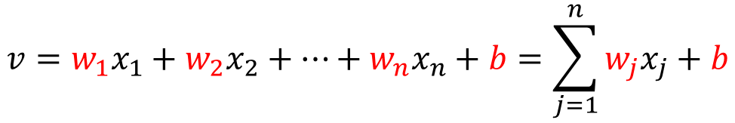
Perceptron (general)
$$y$$
threshold function
+1
Input
signal
Synaptic
weights
1
Bias
b
$$v$$
x₁
w₁
Activation
function
x₂
w₂
Output
Σ
v
ϕ(.)
$$y=φ(v)$$
…
x_{n}
w_{n}
Summing
junction
$${v=w_{1}x}_{1}+{w_{2}x}_{2}+…+{w_{n}x}_{n}+b=\sum_{j=1}^{n}{w_{j}x_{j}+b}$$
11

Slide 12
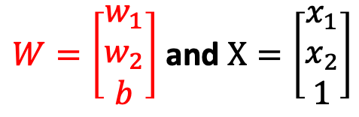



Perceptron
$${v=w_{1}x}_{1}+{w_{2}x}_{2}+b=W^{T}X$$
$W=\left[\begin{matrix}w_{1} \\ w_{2} \\ b\end{matrix}\right]$ and $X=\left[\begin{matrix}x_{1} \\ x_{2} \\ 1\end{matrix}\right]$
$W^{T}=[w_{1}$ $w_{2}$ $b$]
$$W^{T}X= [w_{1} w_{2} b\text{]∗}\left[\begin{matrix}x_{1} \\ x_{2} \\ 1\end{matrix}\right]={w_{1}x}_{1}+{w_{2}x}_{2}+b$$
12

Slide 13
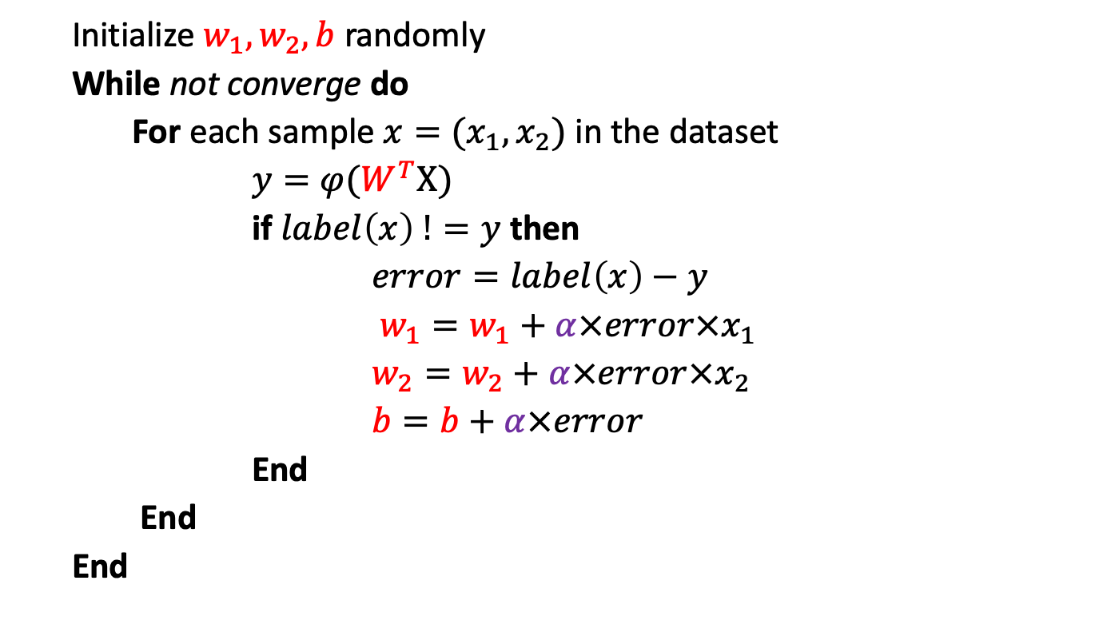


Perceptron Learning (2 Inputs)
$$y$$
+1
1
x₁
w₁
b
$$v$$
Σ
v
ϕ(.)
$$y=φ(v)$$
Initialize $w_{1},w_{2}, b$ randomly
While not converge do
For each sample${ x=(x}_{1},x_{2})$ in the dataset
$y=φ(W^{T}X)$
if $label\left(x\right) !=y$ then
$error=label\left(x\right)−y$
$w_{1}=w_{1}+α×error×x_{1}$
$w_{2}=w_{2}+α×error×x_{2}$
$b=b+α×error$
End
End
End
x₂
w₂
$α$ is learning rate (e.g. 0.1, 0.001)
13

Slide 14
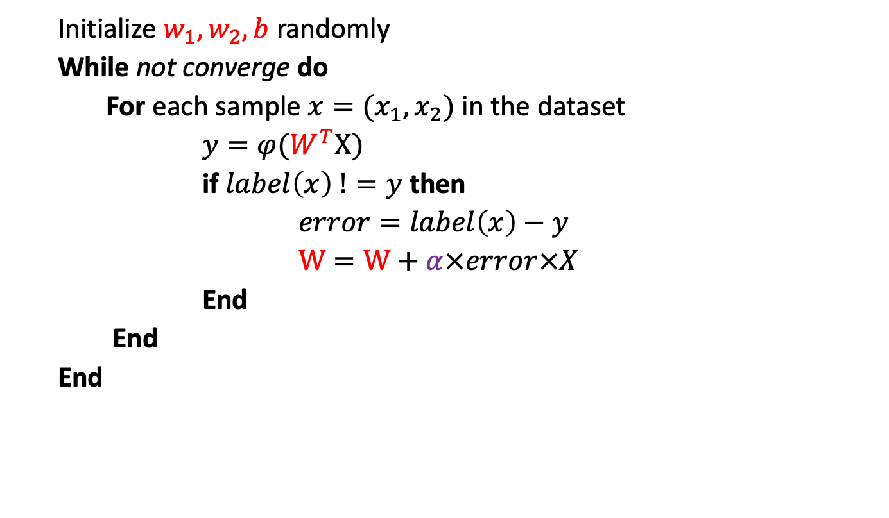

Perceptron Learning (2 Inputs)
$$y$$
+1
1
x₁
w₁
b
$$v$$
Σ
v
ϕ(.)
$$y=φ(v)$$
x₂
w₂
Initialize $w_{1},w_{2}, b$ randomly
While not converge do
For each sample${ x=(x}_{1},x_{2})$ in the dataset
$y=φ(W^{T}X)$
if $label\left(x\right) !=y$ then
$error=label\left(x\right)−y$
$W=W+α×error×X$
End
End
End
14
$α$ is learning rate (e.g. 0.1, 0.001)

Slide 15
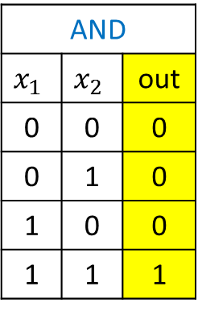
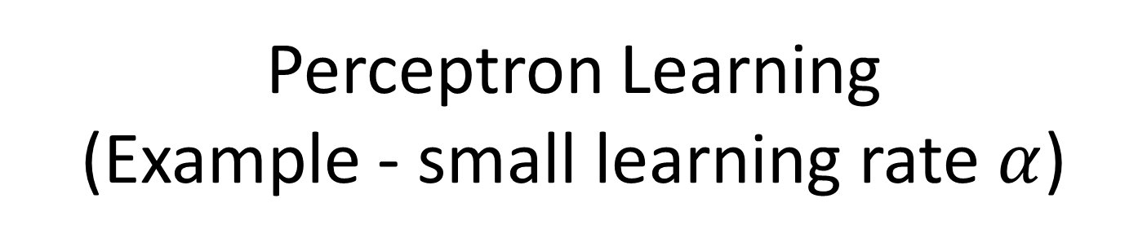
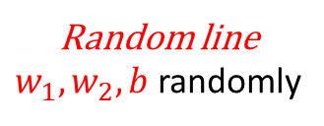


Perceptron Learning
(Example - small learning rate $α$)
AND
$$x_{1}$$ | $$x_{2}$$ | out
0 | 0 | 0
0 | 1 | 0
1 | 0 | 0
1 | 1 | 1
$$x_{1}$$
$$W=W+α×error×X$$
I am not good
Please come closer to me
I am good
I am good
0
1
0
0
$$x_{2}$$
I am good
I am good
Random line
$w_{1},w_{2}, b$ randomly

Slide 16
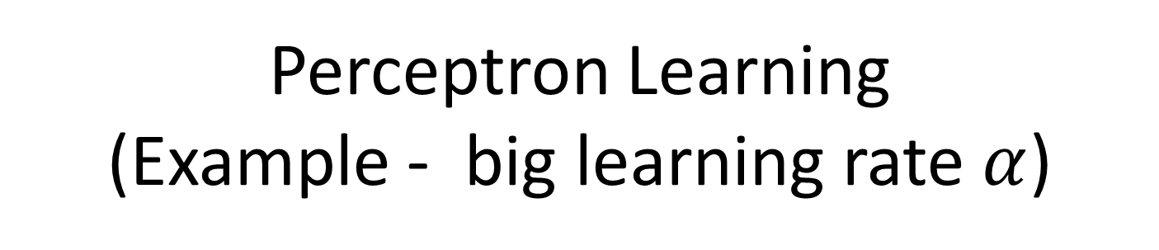
Perceptron Learning
(Example - big learning rate $α$)
AND
$$x_{1}$$ | $$x_{2}$$ | out
0 | 0 | 0
0 | 1 | 0
1 | 0 | 0
1 | 1 | 1
$$x_{1}$$
$$W=W+α×error×X$$
I am not good
Please come closer to me
I am good
0
1
0
0
$$x_{2}$$
I am good
I am good
Random line
$w_{1},w_{2}, b$ randomly

Slide 17
Perceptron Learning
(Example - big learning rate $α$)
AND
$$x_{1}$$ | $$x_{2}$$ | out
0 | 0 | 0
0 | 1 | 0
1 | 0 | 0
1 | 1 | 1
$$x_{1}$$
$$W=W+α×error×X$$
I am good
0
1
I am not good
Please come closer to me
0
0
$$x_{2}$$
I am good
I am good
Random line
$w_{1},w_{2}, b$ randomly

Slide 18
Perceptron Learning
(Example - big learning rate $α$)
AND
$$x_{1}$$ | $$x_{2}$$ | out
0 | 0 | 0
0 | 1 | 0
1 | 0 | 0
1 | 1 | 1
$$x_{1}$$
$$W=W+α×error×X$$
I am not good
Please come closer to me
I am good
0
1
0
0
$$x_{2}$$
I am good
I am good
Random line
$w_{1},w_{2}, b$ randomly

Slide 19
Perceptron Learning
(Example - big learning rate $α$)
AND
$$x_{1}$$ | $$x_{2}$$ | out
0 | 0 | 0
0 | 1 | 0
1 | 0 | 0
1 | 1 | 1
$$x_{1}$$
I am not good
Please come closer to me
I am good
0
1
0
0
$$x_{2}$$
I am good
I am good
Random line
$w_{1},w_{2}, b$ randomly

Slide 20
Perceptron Learning (2 Inputs)
$$y$$
+1
1
x₁
w₁
b
$$v$$
Σ
v
ϕ(.)
$$y=φ(v)$$
Initialize $w_{1},w_{2}, b$ randomly
While not converge do
For each sample${ x=(x}_{1},x_{2})$ in the dataset
$y=φ(W^{T}X)$
if $label\left(x\right) !=y$ then
$error=label\left(x\right)−y$
$W=W+α×error×X$
End
End
End
x₂
w₂
20
$α$ is learning rate (e.g. 0.1, 0.001)

Slide 21
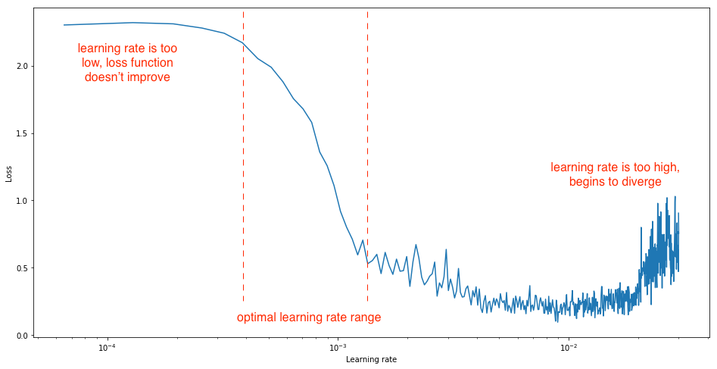

Effects of learning rate $α$
21

Slide 22




Trained Network
(AND)
AND
$$x_{1}$$ | $$x_{2}$$ | out
0 | 0 | 0
0 | 1 | 0
1 | 0 | 0
1 | 1 | 1
$$y$$
+1
1
Bias
b=-1.5
$$v$$
x₁
w₁=1
Activation
function
Σ
Output
v
ϕ(.)
$$y=φ(v)$$
x₂
w₂=1
$${y=φ(1x}_{1}+{1x}_{2}−1.5)$$
22

Slide 23

Trained Network
(AND)
AND
$$x_{1}$$ | $$x_{2}$$ | out
0 | 0 | 0
0 | 1 | 0
1 | 0 | 0
1 | 1 | 1
$$x_{1}$$
0
1
$${1x}_{1}+{1x}_{2}−1.5=0$$
0
0
$$x_{2}$$
23

Slide 24


Discrete vs. Continuous
Step function (hard threshold)
$$y$$
threshold function
+1
Input
signal
Synaptic
weights
1
Bias
b
$$v$$
x₁
w₁
Activation
function
Σ
Output
v
ϕ(.)
$$y=φ(v)$$
Output is 0 or 1
x₂
w₂
Summing
junction
$${v=w_{1}x}_{1}+{w_{2}x}_{2}+b$$
24

Slide 25


Discrete vs. Continuous
Step function (hard threshold)
Discrete
e.g. Step function
$$x_{1}$$
Yes “1”
Yes “1”
No “0”
Yes “1”
No “0”
No “0”
$$x_{2}$$
25

Slide 26
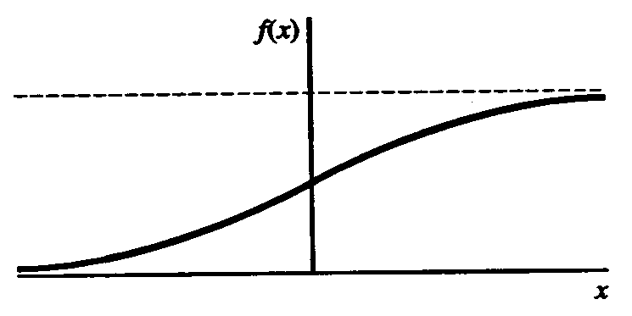
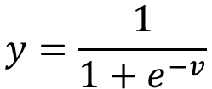



Discrete vs. Continuous
Sigmoid function
$$y=\frac{1}{1+e^{−v}}$$
Sigmoid function
$$y$$
Input
signal
Synaptic
weights
1
Bias
b
$$v$$
x₁
w₁
Activation
function
Σ
Output
v
ϕ(.)
$$y=φ(v)$$
Output is probability
between 0 and 1
x₂
w₂
Summing
junction
$${v=w_{1}x}_{1}+{w_{2}x}_{2}+b$$
26

Slide 27
Discrete vs. Continuous
Sigmoid function
$$y=\frac{1}{1+e^{−v}}$$
Sigmoid
Sigmoid function
$$y$$
Input
signal
Synaptic
weights
1
Bias
b
$$v$$
x₁
w₁
Activation
function
Σ
Output
v
ϕ(.)
$$y=φ(v)$$
Output is probability
between 0 and 1
x₂
w₂
Summing
junction
Question: For a binary classification, we need to calculate the probability of class 0 and class 1. How to interpret the output of the above Sigmoid activation function?
27

Slide 28



Discrete vs. Continuous
Discrete
e.g. Step function
Continuous
e.g. Sigmoid function
$$x_{1}$$
Yes “1”
0.70 likely
Yes “1”
0.85 likely
No “0”
0.40 likely
Yes “1”
0.60 likely
No “0”
0.20 likely
No “0”
$$x_{2}$$
0.30 likely
$$x_{2}$$
Question: For a binary classification, we need to calculate the probability of class 0 and class 1. How to interpret the output of the above Sigmoid activation function? We define a class of interest (e.g., BLUE)
28

Slide 29


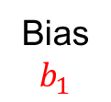



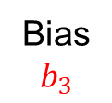


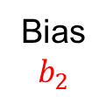


Multi-Class Classification
Softmax
So far, we used Sigmoid activation function to output a probability for a binary (2 class classification) classification
What about multi-class classification?
$$P\left(C_{1}\right)+P\left(C_{2}\right)+P\left(C_{3}\right)=1$$
1
Bias
$$b_{1}$$
$$v_{1}$$
$$φ(v_{1})$$
Synaptic
weights
Σ
$$P(C_{1})$$
Input
signal
1
Bias
$$b_{2}$$
w₁₁
x₁
w₁₂
w₁₃
$$v_{2}$$
Σ
$$φ(v_{2})$$
$$P(C_{2})$$
w₂₁
w₂₂
1
x₂
Bias
$$b_{3}$$
w₂₃
$$v_{3}$$
Σ
$$φ(v_{3})$$
$$P(C_{3})$$
29

Slide 30
Multi-Class Classification
Softmax
So far, we used Sigmoid activation function to output a probability for a binary (2 class classification) classification
What about multi-class classification?
1
Bias
$$b_{1}$$
We cannot use Sigmoid Activation Function
$$v_{1}$$
$$φ(v_{1})$$
Synaptic
weights
Σ
$$P(C_{1})$$
Input
signal
1
Bias
$$b_{2}$$
w₁₁
x₁
w₁₂
w₁₃
$$v_{2}$$
Σ
$$φ(v_{2})$$
$$P(C_{2})$$
w₂₁
w₂₂
1
x₂
Bias
$$b_{3}$$
w₂₃
$$v_{3}$$
Σ
$$φ(v_{3})$$
$$P(C_{3})$$
30

Slide 31
Multi-Class Classification
Softmax
So far, we used Sigmoid activation function to output a probability for a binary (2 class classification) classification
What about multi-class classification?
1
Bias
$$b_{1}$$
$$v_{1}$$
?
Synaptic
weights
Σ
$$P(C_{1})$$
Input
signal
1
Bias
$$b_{2}$$
w₁₁
x₁
w₁₂
w₁₃
$$v_{2}$$
Σ
$$P(C_{2})$$
w₂₁
w₂₂
1
x₂
Bias
$$b_{3}$$
w₂₃
$$v_{3}$$
Σ
$$P(C_{3})$$
31

Slide 32
Softmax
How to turn these 3 real numbers ($v_{1},v_{2}$ and $v_{3}$) into 3 probability values?
Note that $P\left(C_{1}\right)+P\left(C_{2}\right)+P\left(C_{3}\right)=1$
1
Bias
$$b_{1}$$
$$v_{1}$$
Synaptic
weights
Σ
This output is a real number
Input
signal
1
Bias
$$b_{2}$$
w₁₁
x₁
w₁₂
w₁₃
$$v_{2}$$
This output is a real number
Σ
w₂₁
w₂₂
1
x₂
Bias
$$b_{3}$$
w₂₃
$$v_{3}$$
Σ
This output is a real number
32

Slide 33
Softmax
How to turn these 3 real numbers ($v_{1},v_{2}$ and $v_{3}$) into 3 probability values?
Note that $P\left(C_{1}\right)+P\left(C_{2}\right)+P\left(C_{3}\right)=1$
1
Turn to
positive
number
Bias
$$b_{1}$$
Normalize
$$v_{1}$$
$$\frac{e^{v_{1}}}{e^{v_{1}}+e^{v_{2}}+e^{v_{3}}}$$
Synaptic
weights
Σ
$$e^{v_{1}}$$
Input
signal
1
Bias
$$b_{2}$$
w₁₁
x₁
w₁₂
w₁₃
$$v_{2}$$
$$\frac{e^{v_{2}}}{e^{v_{1}}+e^{v_{2}}+e^{v_{3}}}$$
Σ
$$e^{v_{2}}$$
w₂₁
w₂₂
1
x₂
Bias
$$b_{3}$$
w₂₃
$$v_{3}$$
$$\frac{e^{v_{3}}}{e^{v_{1}}+e^{v_{2}}+e^{v_{3}}}$$
Σ
$$e^{v_{3}}$$

Slide 34
Softmax
Note that $P\left(C_{1}\right)+P\left(C_{2}\right)+P\left(C_{3}\right)=1$
Softmax Layer
1
Turn to
positive
number
Bias
$$b_{1}$$
Normalize
$$v_{1}$$
$$\frac{e^{v_{1}}}{e^{v_{1}}+e^{v_{2}}+e^{v_{3}}}$$
Synaptic
weights
Σ
$$e^{v_{1}}$$
$$P(C_{1})$$
Input
signal
1
Bias
$$b_{2}$$
w₁₁
x₁
w₁₂
w₁₃
$$v_{2}$$
$$\frac{e^{v_{2}}}{e^{v_{1}}+e^{v_{2}}+e^{v_{3}}}$$
Σ
$$e^{v_{2}}$$
$$P(C_{2})$$
w₂₁
w₂₂
1
x₂
Bias
$$b_{3}$$
w₂₃
$$v_{3}$$
$$\frac{e^{v_{3}}}{e^{v_{1}}+e^{v_{2}}+e^{v_{3}}}$$
Σ
$$e^{v_{3}}$$
$$P(C_{3})$$

Slide 35
SCC.361: Artificial Intelligence
2024-2025
Week 07 – Lecture 2
Introduction to Neural Networks Cont.
Hossein Rahmani
Prof in Computer Vision and Machine Learning
Email: h.rahmani@lancaster.ac.uk

Slide 36
Outline
Decision Surface
Perceptron
Binary classification
Discrete vs Continuous Perceptron
Multi-class classification
Softmax function
Error/Loss functions
Mean Square Error (MSE)
Maximum Likelihood (ML)
Cross-Entropy (CE)
Multi Layer Perceptron (MLP)

Slide 37
Review: Softmax
Note that $P\left(C_{1}\right)+P\left(C_{2}\right)+P\left(C_{3}\right)=1$
Softmax Layer
1
Turn to
positive
number
Bias
$$b_{1}$$
Normalize
$$v_{1}$$
$$\frac{e^{v_{1}}}{e^{v_{1}}+e^{v_{2}}+e^{v_{3}}}$$
Synaptic
weights
Σ
$$e^{v_{1}}$$
$$P(C_{1})$$
Input
signal
1
Bias
$$b_{2}$$
w₁₁
x₁
w₁₂
w₁₃
$$v_{2}$$
$$\frac{e^{v_{2}}}{e^{v_{1}}+e^{v_{2}}+e^{v_{3}}}$$
Σ
$$e^{v_{2}}$$
$$P(C_{2})$$
w₂₁
w₂₂
1
x₂
Bias
$$b_{3}$$
w₂₃
$$v_{3}$$
$$\frac{e^{v_{3}}}{e^{v_{1}}+e^{v_{2}}+e^{v_{3}}}$$
Σ
$$e^{v_{3}}$$
$$P(C_{3})$$

Slide 38


Softmax vs. Sigmoid
Sigmoid is suitable for binary classification
Question: Can we use Softmax for binary classification?
Input
signal
1
Bias
$$b_{1}$$
x₁
w₁
$$v_{1}$$
$$φ(v_{1})$$
Σ
$$P(C_{1})$$
w₂
x₂

Slide 39
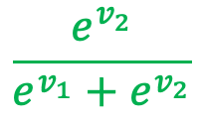
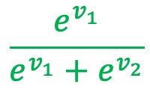


Softmax vs. Sigmoid
Sigmoid is suitable for binary classification
Question: Can we use Softmax for binary classification?
1
Turn to
positive
number
Bias
$$b_{1}$$
Normalize
Input
signal
w₁₁
$$v_{1}$$
$$\frac{e^{v_{1}}}{e^{v_{1}}+e^{v_{2}}}$$
Σ
$$e^{v_{1}}$$
x₁
w₁₂
1
Bias
$$b_{2}$$
w₂₁
x₂
$$v_{2}$$
$$\frac{e^{v_{2}}}{e^{v_{1}}+e^{v_{2}}}$$
w₂₂
Σ
$$e^{v_{2}}$$

Slide 40
Loss Functions
How to measure the performance of a model during training?
Let’s assume the models below. Which model is better?
Metrics:
Mean Square Error (MSE) for regression problems
Maximum Likelihood
Cross Entropy for classification problems
Model 1
Model 2
$$x_{1}$$
$$x_{1}$$
0.70 likely
0.75 likely
0.85 likely
0.60 likely
0.40 likely
0.65 likely
0.60 likely
0.40 likely
0.20 likely
0.30 likely
0.30 likely
$$x_{2}$$
0.25 likely
$$x_{2}$$

Slide 41
Mean Squared Error (MSE)
The best model is a model that gives lower average squared difference between the predicted values and the actual values.
$$\frac{1}{N}\sum_{i=1}^{N}{{{(y}_{i}−P_{i})}^{2}}$$
$$y_{i}=\left\{\begin{aligned} \\ \end{aligned}\right.$$
1
Number of
Samples (e.g. 6)
0
Model 1
Model 2
$$x_{1}$$
$$x_{1}$$
0.70 likely
0.75 likely
0.85 likely
0.60 likely
0.40 likely
0.65 likely
0.60 likely
0.40 likely
0.20 likely
0.30 likely
0.30 likely
$$x_{2}$$
0.25 likely
$$x_{2}$$

Slide 42
Maximum Likelihood
The best model is a model that gives higher probability to the correct class.
The method is called Maximum Likelihood
Model 1
Model 2
$$x_{1}$$
$$x_{1}$$
0.70 likely
0.75 likely
0.85 likely
0.60 likely
0.40 likely
0.65 likely
0.60 likely
0.40 likely
0.20 likely
0.30 likely
0.30 likely
$$x_{2}$$
0.25 likely
$$x_{2}$$

Slide 43
Maximum Likelihood
Why the model 2 is better from the probability perspective (Maximum Likelihood)?
Below shows the probability of a sample be BLUE (which is the output of the Sigmoid activation function)
Model 1
Model 2
$$x_{1}$$
$$x_{1}$$
0.70 likely
0.75 likely
0.85 likely
0.60 likely
0.40 likely
0.65 likely
0.60 likely
0.40 likely
0.20 likely
0.30 likely
0.30 likely
$$x_{2}$$
0.25 likely
$$x_{2}$$

Slide 44
Maximum Likelihood
Why the model 2 is better from the probability perspective (Maximum Likelihood)?
Below shows the probability of a sample be RED
Model 1
Model 2
$$x_{1}$$
$$x_{1}$$
0.30 likely
0.25 likely
0.15 likely
0.40 likely
0.60 likely
0.35 likely
0.40 likely
0.60 likely
0.80 likely
0.70 likely
0.70 likely
$$x_{2}$$
0.75 likely
$$x_{2}$$

Slide 45
Maximum Likelihood
Why the model 2 is better from the probability perspective (Maximum Likelihood)?
Step 1: Both probabilities have been shown for each sample for each model
Model 1
Model 2
$$x_{1}$$
0.70 likely
$$x_{1}$$
0.75 likely
0.30 likely
0.25 likely
0.85 likely
0.60 likely
0.15 likely
0.40 likely
0.40 likely
0.65 likely
0.60 likely
0.35 likely
0.60 likely
0.40 likely
0.40 likely
0.60 likely
0.20 likely
0.30 likely
0.80 likely
0.70 likely
0.30 likely
$$x_{2}$$
0.25 likely
$$x_{2}$$
0.70 likely
0.75 likely

Slide 46
Maximum Likelihood
Step 1: Both probabilities have been shown for each sample for each model
Step 2: Calculate the probability of all 6 samples are of the classes that they actually are
Model 1
$$x_{1}$$
0.70 likely
$$0.85×0.70×0.40×0.70×0.40×0.80=0.053312$$
0.30 likely
0.85 likely
0.15 likely
Probability for
Model 1
0.40 likely
0.60 likely
0.60 likely
0.40 likely
0.20 likely
0.80 likely
0.30 likely
$$x_{2}$$
46
0.70 likely

Slide 47
Maximum Likelihood
Step 1: Both probabilities have been shown for each sample for each model
Step 2: Calculate the probability of all 6 samples are of the classes that they actually are
Model 2
$$x_{1}$$
0.75 likely
$$0.60×0.75×0.65×0.60×0.75×0.70=0.0921375$$
0.25 likely
0.60 likely
0.40 likely
Probability for
Model 2
0.65 likely
0.35 likely
0.40 likely
0.60 likely
0.30 likely
0.70 likely
0.25 likely
$$x_{2}$$
47
0.75 likely

Slide 48
Maximum Likelihood
Probability for
Model 1
Probability for
Model 2
$$0.053312$$
$$0.0921375$$
Model 1
Model 2
$$x_{1}$$
0.70 likely
$$x_{1}$$
0.75 likely
0.30 likely
0.25 likely
0.85 likely
0.60 likely
0.15 likely
0.40 likely
0.40 likely
0.65 likely
0.60 likely
0.35 likely
0.60 likely
0.40 likely
0.40 likely
0.60 likely
0.20 likely
0.30 likely
0.80 likely
0.70 likely
0.30 likely
$$x_{2}$$
0.25 likely
$$x_{2}$$
0.70 likely
0.75 likely

Slide 49
Issues with Maximum Likelihood
So, the aim of learning (for classification) is to maximize this probability of the model
How to maximize this probability?
Product of probabilities (one probability for each sample)
It is hard to maximize products
Moreover, if there are hundreds/thousands of samples, the product of them is very tiny (e.g. 0.000000000003)
Solution: We need to resolve these issues by turning the products to sums!!!
$\log\left(A×B\right)=log\left(A\right)+log(B)$
$\ln\left(A×B\right)=ln\left(A\right)+ln(B)$
49

Slide 50
Maximum Likelihood => Cross-Entropy
$\ln\left(A×B\right)=ln\left(A\right)+ln(B)$
Likelihood of
Model 1
$$0.85×0.70×0.40×0.70×0.40×0.80=0.053312$$
$$\ln\left(0.85×0.70×0.40×0.70×0.40×0.80\right)=…$$
$$…=ln\left(0.85\right)+\ln\left(0.70\right)+\ln\left(0.40\right)+\ln\left(0.70\right)+\ln\left(0.40\right)+ln⁡(0.80)=$$
$$…=\left(−0.16\right)+\left(−\text{0.3}6\right)+\text{(}−\text{0.9}2)+(−0.36)+(−0.92)+(−0.22)=−2.94$$
Result is always a negative number
$$…=−ln\left(0.85\right)−\ln\left(0.70\right)−\ln\left(0.40\right)−\ln\left(0.70\right)−\ln\left(0.40\right)−ln⁡(0.80)=$$
$$…=−\left(−0.16\right)−\left(−\text{0.3}6\right)−\text{(}−\text{0.9}2)−(−0.36)−(−0.92)−(−0.22)=2.94$$
Result is always a positive number
This negative sum of the log probabilities is called
Cross-Entropy
50

Slide 51
Maximum Likelihood => Cross-Entropy
$\ln\left(A×B\right)=ln\left(A\right)+ln(B)$
Likelihood of
Model 2
$$0.60×0.75×0.65×0.60×0.75×0.70=0.0921375$$
$$−ln\left(0.60×0.75×0.65×0.60×0.75×0.70\right)=…$$
$$…=−ln\left(0.60\right)−\ln\left(0.75\right)−\ln\left(0.65\right)−\ln\left(0.60\right)−\ln\left(0.75\right)−ln⁡(0.70)=$$
$$…=−\left(−0.51\right)−\left(−\text{0.}29\right)−\text{(}−\text{0.}43)−(−0.51)−(−0.29)−(−0.36)=2.39$$
This negative sum of the log probabilities is called
Cross-Entropy
51

Slide 52
Cross-Entropy
The aim of learning (for classification) is to maximize the Maximum Likelihood of the model
Now, our aim is to minimize the Cross-Entropy of the model
Likelihood of
Model 1
$$0.85×0.70×0.40×0.70×0.40×0.80=0.053312$$
$$−ln\left(0.85\right)−\ln\left(0.70\right)−\ln\left(0.40\right)−\ln\left(0.70\right)−\ln\left(0.40\right)−ln⁡(0.80)=2.94$$
Cross-Entropy
of Model 1
Likelihood of
Model 2
$$0.60×0.75×0.65×0.60×0.75×0.70=0.0921375$$
$$−ln\left(0.60\right)−\ln\left(0.75\right)−\ln\left(0.65\right)−\ln\left(0.60\right)−\ln\left(0.75\right)−ln⁡(0.70)=2.39$$
Cross-Entropy
of Model 2
52

Slide 53
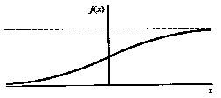
Cross-Entropy Equation
Model 1
$$x_{1}$$
0.70 likely
Synaptic
weights
1
Input
signal
0.85 likely
Bias
b
x₁
w₁
0.40 likely
Σ
v
0.60 likely
ϕ(.)
$$P(BLUE)$$
0.20 likely
0.30 likely
$$x_{2}$$
x₂
w₂
Summing
junction
$$−ln\left(0.85\right)−\ln\left(0.70\right)−\ln\left(0.40\right)−\ln\left(0.70\right)−\ln\left(0.40\right)−ln⁡(0.80)=2.94$$
Cross-Entropy
of Model 1
$$−\sum_{i=1}^{N}{y_{i}\ln\left(P_{i}\right)+{(1−y}_{i}) ln⁡(1−P_{i})}$$
$$y_{i}=\left\{\begin{aligned} \\ \end{aligned}\right.$$
1
Number of
Samples (e.g. 6)
0
53

Slide 54
Multi-Class Cross-Entropy
1
Bias
$$b_{1}$$
$$v_{1}$$
Synaptic
weights
Σ
$$P(C_{1})$$
Number of
Samples
Number of
Classes
Input
signal
1
Bias
$$b_{2}$$
w₁₁
$$−\sum_{i=1}^{N}{\sum_{j=1}^{C}{y_{i,j}\ln\left(P_{i,j}\right)}}$$
x₁
w₁₂
$$v_{2}$$
w₁₃
Softmax Layer
Σ
$$P(C_{2})$$
w₂₁
w₂₂
1
If $i^{th}$ sample belongs to
class $C_{j}$, then: $y_{i,j}=1$
x₂
Bias
$$b_{3}$$
w₂₃
$$v_{3}$$
Σ
$$P(C_{3})$$
54

Slide 55
Non-linear
Decision Boundary
$$x_{1}$$
Non-linear
Decision
Boundary
B
A
B
A
Non-Linearly separable
One perceptron is not enough
A
A
B
A
A
A
B
B
B
B
B
$$x_{2}$$
55

Slide 56
Simple Network
(XOR)
XOR
$$x_{1}$$ | $$x_{2}$$ | out
0 | 0 | 0
0 | 1 | 1
1 | 0 | 1
1 | 1 | 0
$$x_{1}$$
1
0
Non-Linearly separable
One perceptron is not enough
$${w_{1}x}_{1}+{w_{2}x}_{2}+b_{1}=0$$
0
1
$$x_{2}$$
$${w_{3}x}_{1}+{w_{4}x}_{2}+b_{2}=0$$
56

Slide 57
Simple Network
(XOR)
1
XOR
$$x_{1}$$ | $$x_{2}$$ | out
0 | 0 | 0
0 | 1 | 1
1 | 0 | 1
1 | 1 | 0
Bias
$$b_{1}$$
Σ
$$v_{1}$$
W₁
ϕ(.)
x₁
W₂
1
Bias
$$b_{2}$$
W₃
x₂
Σ
$$v_{2}$$
ϕ(.)
W₄
Input Layer
Hidden Layers
57

Slide 58
Simple Network
(XOR) – First Neuron
$$x_{1}$$
$${w_{1}x}_{1}+{w_{2}x}_{2}+b_{1}=0$$
1
0
0
1
$$x_{2}$$
58

Slide 59
Simple Network
(XOR)
1
XOR
$$x_{1}$$ | $$x_{2}$$ | out
0 | 0 | 0
0 | 1 | 1
1 | 0 | 1
1 | 1 | 0
Bias
$$b_{1}$$
Σ
$$v_{1}$$
W₁
ϕ(.)
x₁
W₂
1
Bias
$$b_{2}$$
W₃
x₂
Σ
$$v_{2}$$
ϕ(.)
W₄
Input Layer
Hidden Layers
59

Slide 60
Simple Network
(XOR) – Second Neuron
$$x_{1}$$
$${w_{3}x}_{1}+{w_{4}x}_{2}+b_{2}=0$$
1
0
0
1
$$x_{2}$$
60

Slide 61
Simple Network
(XOR)
1
XOR
$$x_{1}$$ | $$x_{2}$$ | out
0 | 0 | 0
0 | 1 | 1
1 | 0 | 1
1 | 1 | 0
Bias
$b_{1}$=-1.5
Σ
$$v_{1}$$
W₁=1
ϕ(.)
x₁
W₅=-2
Bias
$b_{3}$=-0.5
W₂=1
1
Σ
v
$$y$$
W₃=1
Bias
$b_{2}$=-0.5
ϕ(.)
x₂
Σ
W₆=1
$$v_{2}$$
ϕ(.)
W₄=1
61

Slide 62
Simple Network
(XOR) – Both Neurons
$$x_{1}$$
$${w_{3}x}_{1}+{w_{4}x}_{2}+b_{2}=0$$
1
0
0
1
$$x_{2}$$
62

Slide 63
Simple Network
(XOR)
$$x_{1}$$
1
0
$${w_{1}x}_{1}+{w_{2}x}_{2}+b_{1}=0$$
0
1
$$x_{2}$$
$${w_{3}x}_{1}+{w_{4}x}_{2}+b_{2}=0$$
63

Slide 64
Simple Network
(Example 2)
$$x_{1}$$
1
1
0
0
0
1
1
0
0
1
0
1
0
0
1
1
0
1
1
0
0
0
0
0
1
1
1
1
1
1
1
1
1
1
1
$$x_{2}$$
64

Slide 65
Simple Network
(Example 2 – First Neuron)
$$x_{1}$$
1
1
0
0
0
1
1
0
0
1
0
1
0
0
1
1
0
$${w_{1}x}_{1}+{w_{2}x}_{2}+b_{1}=0$$
1
1
0
0
0
0
0
1
1
1
1
1
1
1
1
1
1
1
$$x_{2}$$
65

Slide 66
Simple Network
(Example 2 - – Second Neuron)
$$x_{1}$$
$${w_{3}x}_{1}+{w_{4}x}_{2}+b_{2}=0$$
1
1
0
0
0
1
1
0
0
1
0
1
0
0
1
1
0
1
1
0
0
0
0
0
1
1
1
1
1
1
1
1
1
1
1
$$x_{2}$$
66

Slide 67
Simple Network
(Example 2 – Combine)
$$x_{1}$$
$${w_{3}x}_{1}+{w_{4}x}_{2}+b_{2}=0$$
1
1
0
0
0
1
1
0
0
1
0
1
0
0
1
1
0
$${w_{1}x}_{1}+{w_{2}x}_{2}+b_{1}=0$$
1
1
0
0
0
0
0
1
1
1
1
1
1
1
1
1
1
1
$$x_{2}$$

Slide 68
Simple Network
(Example 2 – Combine)
$$x_{1}$$
1
1
0
0
0
1
1
0
0
1
0
1
0
0
1
1
0
1
1
0
0
0
0
0
1
1
1
1
1
1
1
1
1
1
1
$$x_{2}$$
68

Slide 69
Simple Network
(Example 2 – Model )
1
Bias
$$b_{1}$$
1
Σ
$$v_{1}$$
W₁
ϕ(.)
x₁
w₅
Bias
$$b_{3}$$
W₂
1
Σ
v
$$y$$
Bias
$$b_{2}$$
ϕ(.)
W₃
x₂
Σ
w₆
Output
Layer
$$v_{2}$$
ϕ(.)
W₄
Input Layer
Hidden Layers
69

Slide 70
Multi-Layer Perceptron
(One hidden layer)
Input Layer
Hidden Layers
Output
Layer
x₁
x₂
x₃
x₄
x₅
x₆
x₇
=
Σ
ϕ(.)
70

Slide 71
Question: (Example 3)
$$x_{1}$$
1
1
1
1
1
1
0
0
1
1
0
1
0
0
1
0
1
1
0
0
1
0
0
1
1
1
0
0
0
0
1
1
1
1
1
1
1
1
1
1
1
$$x_{2}$$
71

Slide 72
Multi-Layer Perceptron
(Two hidden layers)
Input Layer
Hidden Layers
Output
Layer
x₁
x₂
x₃
x₄
x₅
x₆
x₇
Each element of the preceding layer is connected with each element of the next layer (fully connected).
There is no interconnection between artificial neurons from the same layer.
Each hidden layer is built from artificial neurons

Slide 73
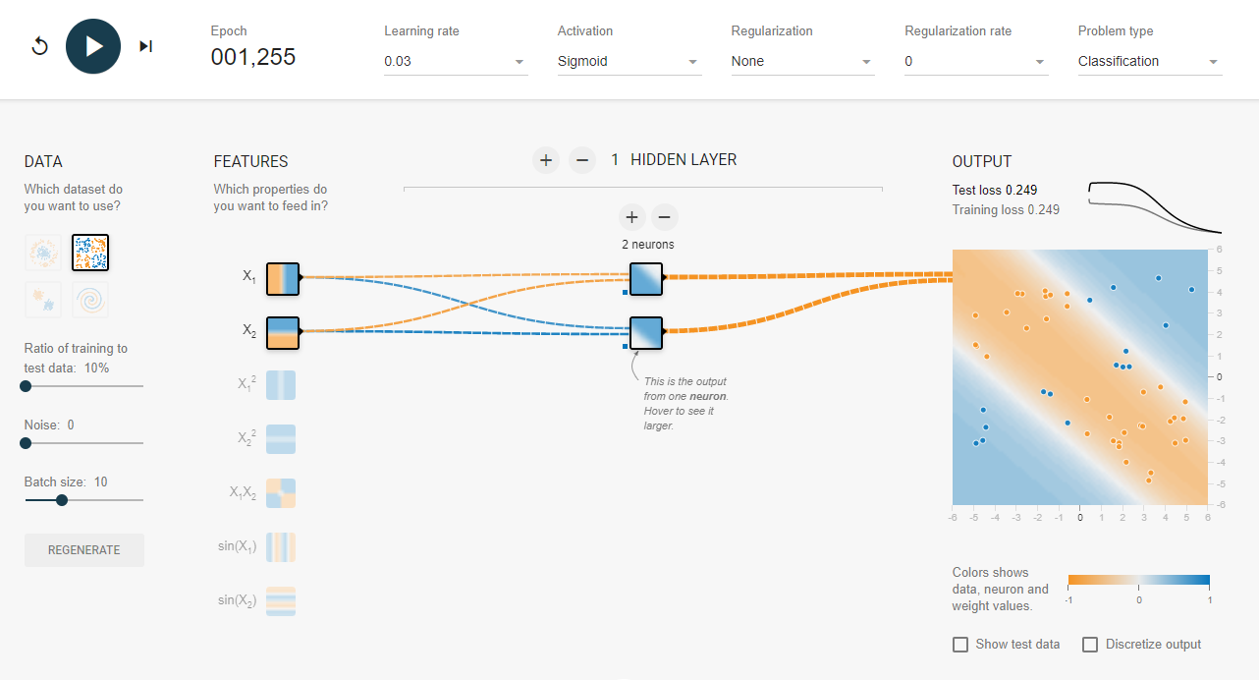
Multi-Layer Perceptron
(Visualizing Decision Boundary)

Slide 74
Why the MLP?
The single-layer perceptron classifiers discussed previously can only deal with linearly separable sets of patterns.
The multilayer networks are the most widespread neural network architecture
Made useful until the 1980s, because of lack of efficient training algorithms
The introduction of the backpropagation training algorithm.

Slide 75
General Architecture
(Binary Classifier)
Input Layer
Hidden Layer $1$
Hidden Layer $n−1$
Hidden Layer $n$
Output
Layer $P(class)$
x₁
…
x₂
x₃
…
$$−\sum_{i=1}^{N}{y_{i}\ln\left(P_{i}\right)+{(1−y}_{i}) ln⁡(1−P_{i})}$$
$$P$$
x₄
Binary Cross-Entropy (Error)
y
x₅
…
x₆
x₇
Label: y
=
Σ
ϕ(.)

Slide 76
General Architecture
(Multi-Class Classifier)
Input Layer
Hidden Layer $1$
Hidden Layer $n−1$
Hidden Layer $n$
Output
Layer
x₁
$$P(C_{1})$$
…
x₂
x₃
$$P(C_{2})$$
…
Softmax Layer
$$−\sum_{i=1}^{N}{\sum_{j=1}^{C}{y_{i,j}\ln\left(P_{i,j}\right)}}$$
x₄
Nulti-Class Cross-Entropy (Error)
$$P(C_{3})$$
x₅
…
x₆
$$P(C_{4})$$
x₇
y
Label: y
=
Σ
ϕ(.)

Slide 77
Training MLP
This process tunes the parameters such that the input space is correctly mapped to the output space.
The current estimate of the output variables is matched with the desired output.
This matching function (e.g. Cross Entropy) serves as an objective function during the MLP training and it is usually called the loss function or the error function.
MLP training process involves the optimization of the model parameters such that the loss function is minimized.
The optimization of such non-linear models is a hard task.
Search for the locally optimal solution at each step
The gradient based methods come as a natural choice

Slide 78
Training MLP
(Backpropagation Algorithm)
The backpropagation algorithm looks for the minimum of the error function in weight space using the method of gradient descent.
The combination of weights which minimizes the error function (e.g. cross-entropy) is considered to be a solution of the learning problem.
Since this method requires computation of the gradient of the error function at each iteration step, we must guarantee the continuity and differentiability of the error function.

Slide 79
Backpropagation
The back propagation algorithm is a generalization of the perceptron learning algorithm
This algorithm updates the weights of the network by means of successive iterations, that minimize the cost function of the error:
The minimization of the error is obtained using the gradient of the cost function:
On the basis of this gradient the weights will be updated with the following mechanism:
$$E=−\sum_{i=1}^{N}{y_{i}\ln\left(P_{i}\right)+{(1−y}_{i}) ln⁡(1−P_{i})}$$
$$\frac{∂}{∂w_{i,j}}(E)$$
$$w_{i,j}=w_{i,j}−α\frac{∂}{∂w_{i,j}}(E)$$

Slide 80
Variants of Gradient Descent
BATCH GRADIENT DESCENT
Computes gradient on the entire training set
The entire dataset to be loaded into memory for each iteration, which can be computationally expensive for large datasets
STOCHASTIC GRADIENT DESCENT
Performs parameter update for each set of input and output present in the training set
Converges much faster compared to the batch gradient descent
Convergence behaviour is usually instable
MINI-BATCH GRADIENT DESCENT
Dividing the training set into a number of mini-batches
An improved form of stochastic gradient descent
Provides a decent trade-off between convergence efficiency and convergence stability

Slide 81
Outline
Multi Layer Perceptron (MLP)
Why it is not good for images
Convolutional Neural Networks (CNN)
Convolution Layer
Activation Function
Pooling Layer
Transposed Convolution (Deconv)
Un-pooling layer

Slide 82
Multi-Layer Perceptron
(Two hidden layers)
Input Layer
Hidden Layers
Output
Layer
x₁
$$w_{1}$$
$$w_{1}$$
$$w_{1}$$
$$w_{29}$$
x₂
$$w_{1}$$
$$w_{30}$$
$$w_{31}$$
$$w_{41}$$
x₃
$$w_{42}$$
x₄
x₅
$$w_{43}$$
x₆
$$w_{40}$$
$$w_{28}$$
x₇
Each element of the preceding layer is connected with each element of the next layer (fully connected).
There is no interconnection between artificial neurons from the same layer.
Each hidden layer is built from artificial neurons

Slide 83
Image Classification
using Features and MLP
Input Layer
Hidden Layer $1$
Hidden Layer $2$
Output
Layer
x₁
x₂
x₃
x₄
Extracted Features as input
x₅
x₆
x₇
=
Σ
ϕ(.)

Slide 84
Multiple Outputs
(more than 2 Class - Classification)
Input Layer
Hidden Layer $1$
Hidden Layer $2$
Hidden Layer $3$
Output
Layer
x₁
$$P(C_{1})$$
x₂
x₃
$$P(C_{2})$$
Softmax Layer
x₄
Extracted Features as input
$$P(C_{3})$$
x₅
x₆
$$P(C_{4})$$
x₇
=
Σ
ϕ(.)
=
Σ

Slide 85

Feature Representations
Class Prediction
Pre-processing
Feature extraction
Feature selection
Input
Feature learner
Feature learning: Instead of design features,
let’s design feature learners

Slide 86
Questions?

